Slide 1
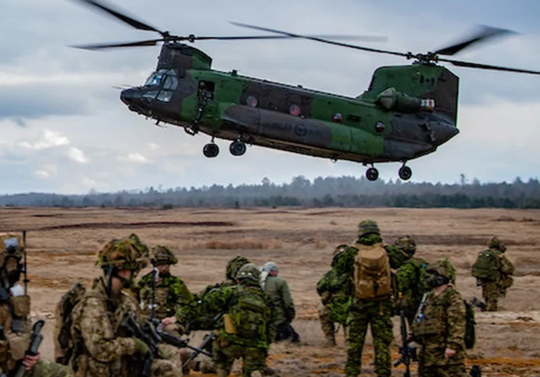
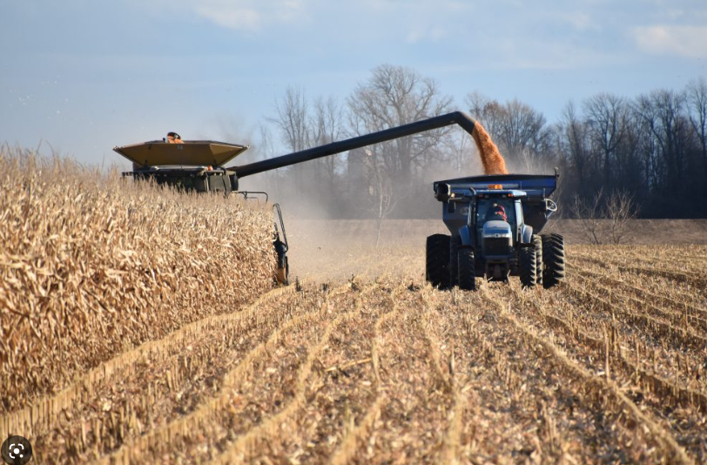
Farming for Our Grandchildren: Leading in the Military and Farming Communities in Times of Chaos

Slide 3
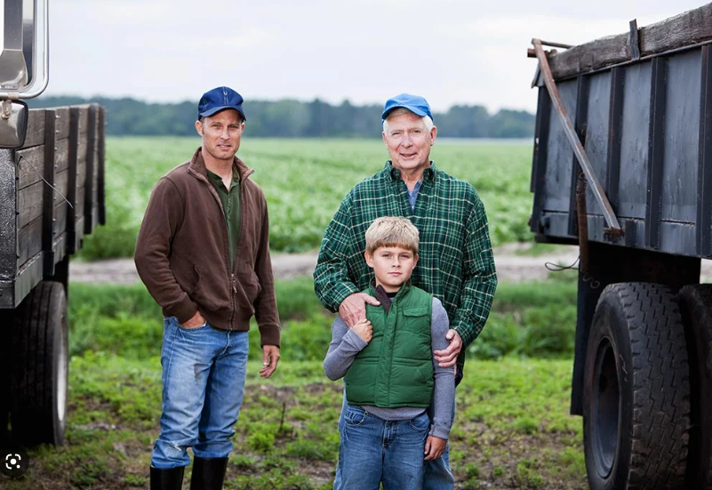
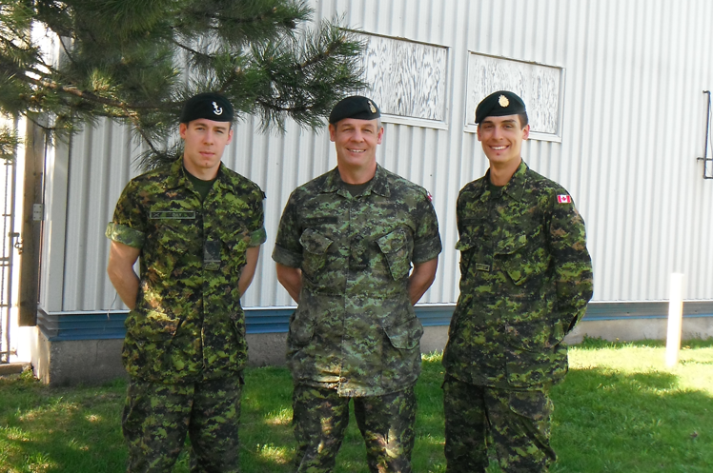

A Family Affair

Slide 4
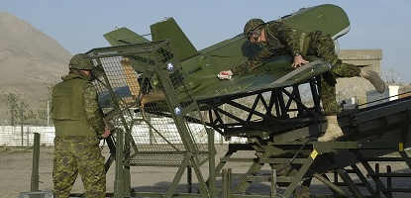
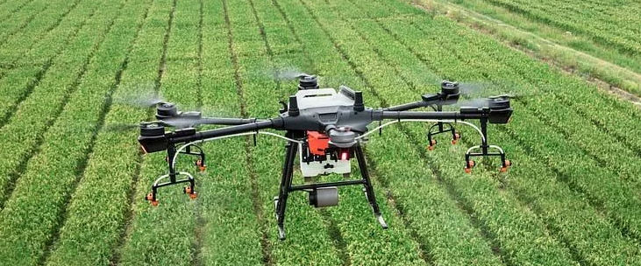
Increasingly Driven by Technology

Slide 5
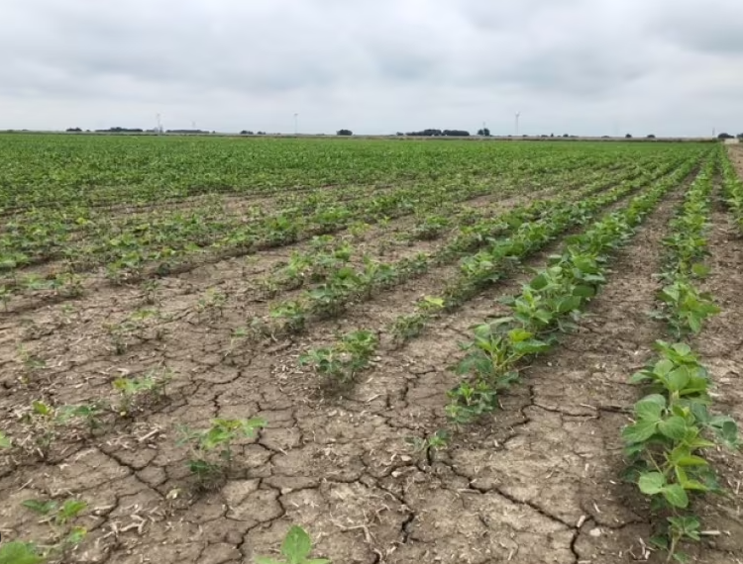
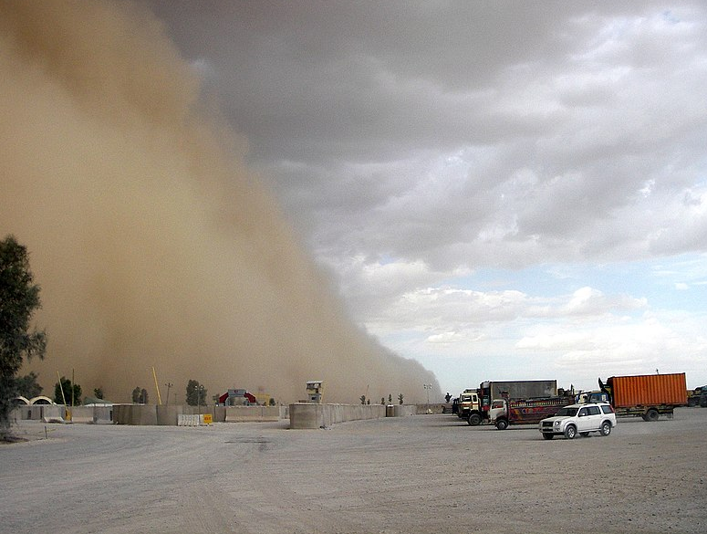
Weather of all types…. Is not a Reason let alone an Excuse

Slide 6
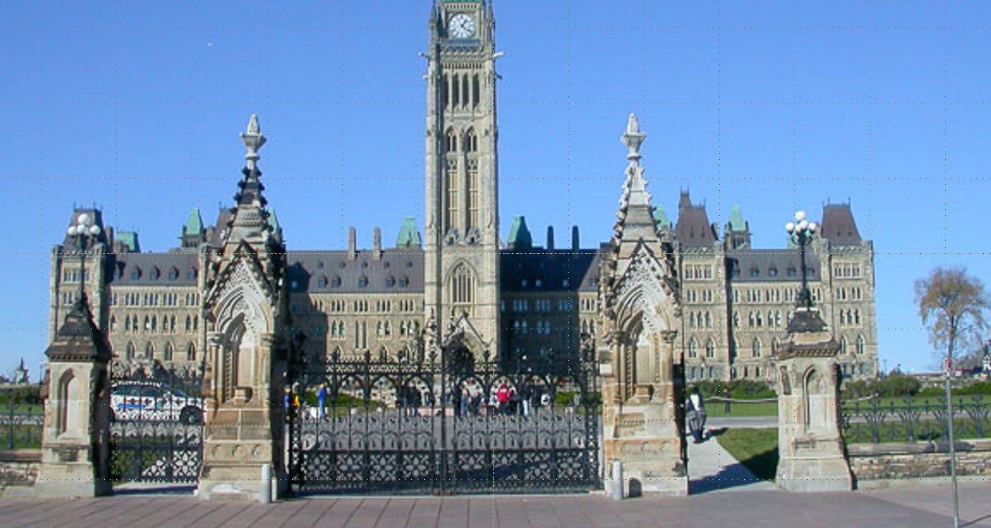
Government….. Is Always (!!) Involved.

Slide 7


Slide 8
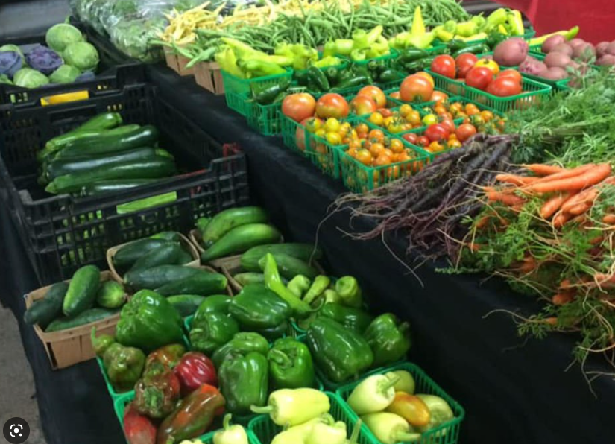
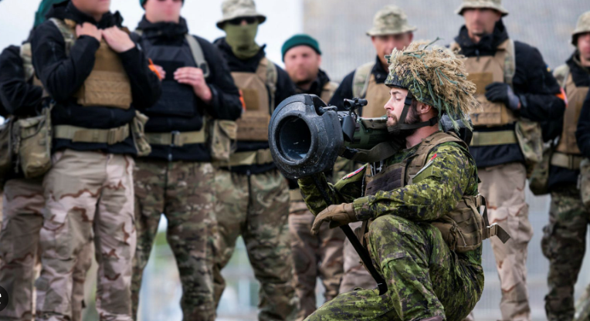
Society’s Quality of Life: Depends on What We Do

Slide 9


Slide 11

Admiring and Describing the Challenge doesn’t actually address the Challenge.

Slide 12

Don’t lose sight of the End State, do that by knowing where you want to end up.

Slide 13
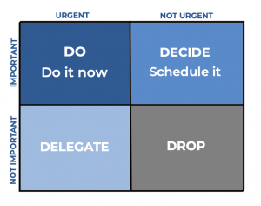
Prioritize and Sequence: Know the difference between the two.

Slide 14

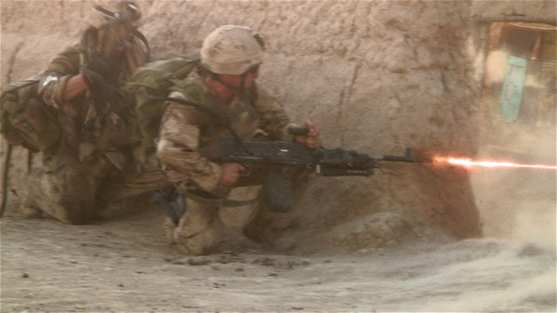
The future is always always important, but some days it doesn’t matter.

Slide 15
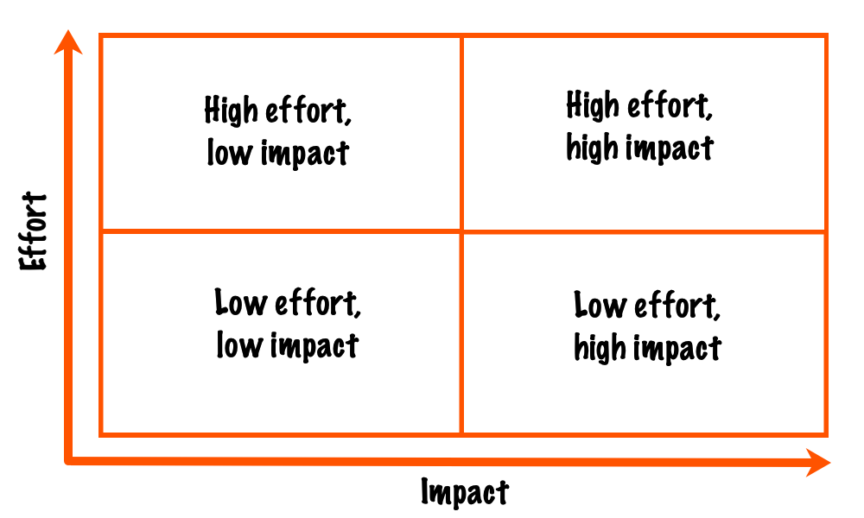
Accept you can only do so much: Plan and Act accordingly.

Slide 16
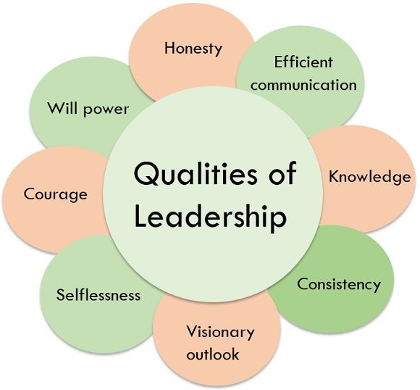
Leadership is about People: Every moment is a leadership moment.

Slide 17
Admiring and Describing the Challenge doesn’t actually address the Challenge.
Don’t lose sight of the End State, do that by knowing where you want to end up.
Learn to Prioritize and Learn to Sequence: Know the difference between the two.
The future is always always important, but some days it doesn’t matter.
Accept you can only do so much: Plan and Act accordingly.
Leadership is about People: Every moment is a leadership moment.

